Slide 1
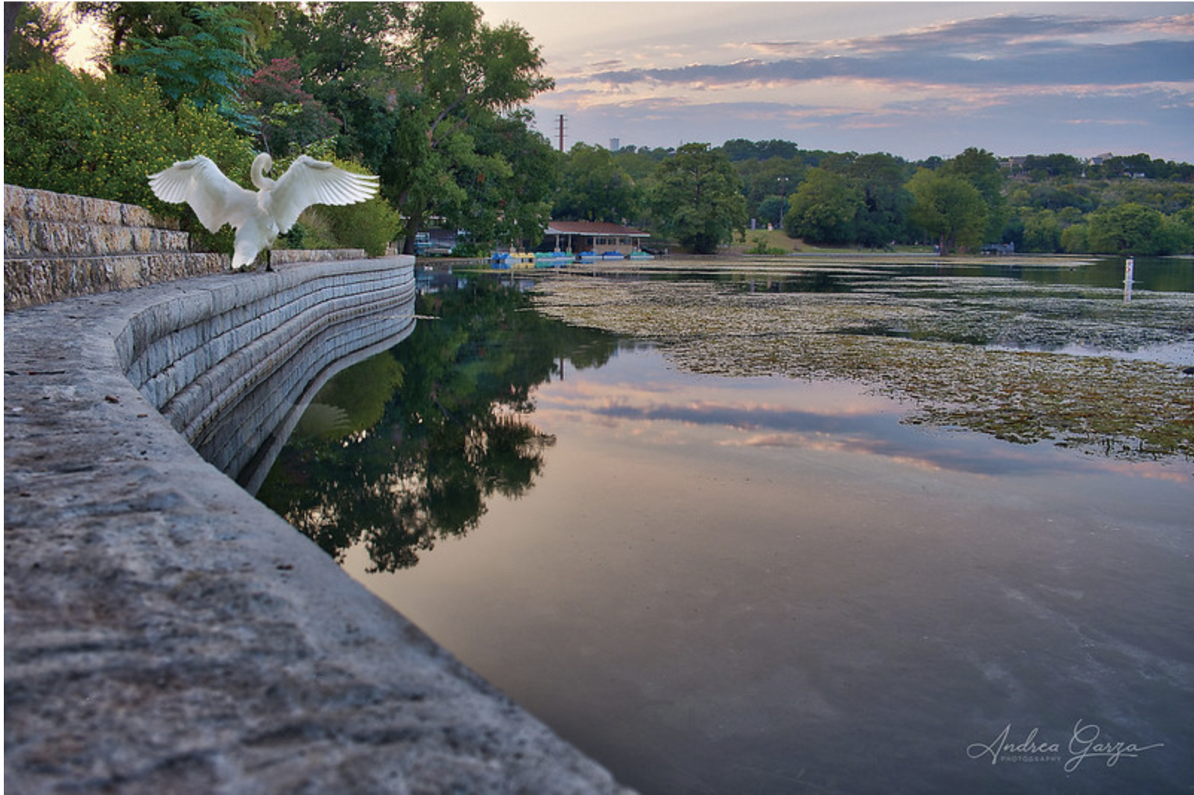
ONE WATER
NEW BRAUNFELS
INTERLOCAL AGREEMENT
PRESENTATION TO
NBU BOARD OF TRUSTEES

Slide 2
Collaboration for our shared resources
t
t
t
ONE WATER ROADMAP

Slide 3
VISION
To ensure water remains a celebrated & protected feature of our community by collaboratively managing our water resources to safeguard watersheds, waterways & groundwater.
1
2
3
4
5
Plan for & manage water resources holistically & sustainably
Maximize environmental, social, & economic benefits
to the greater New Braunfels area
Ensure water remains a celebrated feature of New Braunfels
Provide sustainable & high-quality water
ONE WATER ROADMAP
Ensure healthy watersheds, waterways & groundwater resources

Slide 4
One Water Roadmap
Proactive approach to managing shared resources
Aligned with agency missions
Synergistic with existing/planned programs & plans (Envision New Braunfels, WPPs, Parks Master Plan, EA HCP, & more)
Supports agencies in meeting state & federal regulatory requirements (MS4, Incidental Take Permit, Dry Comal Creek & Comal River WPP, etc)
Provides platform & process for coordinating across agencies
Positive PR & “It’s what our constituents expect us to do”
ONE WATER ROADMAP

Slide 5
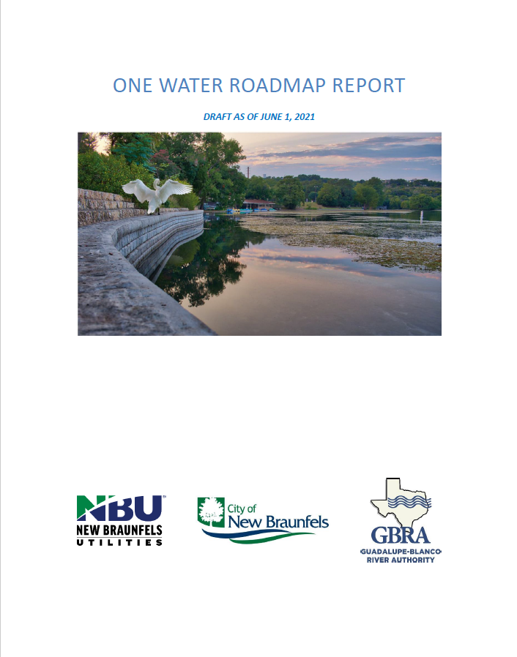
Roadmap Report recommendations
Adopt the One Water Roadmap plan
Develop a formal agreement between three agencies (NBU, City of New Braunfels & GBRA) to collaboratively advance the plan
Hire and onboard One Water Coordinator to advance plan & coordinate program across multiple agencies
Advance “no regrets” and easy-to-execute activities from each Roadmap objective
Leadership from participating agencies will be responsible for successful implementation, such as:
Appointment of Advisory Council members
Hiring One Water Coordinator
Establishing Working Groups
ONE WATER ROADMAP

Slide 6
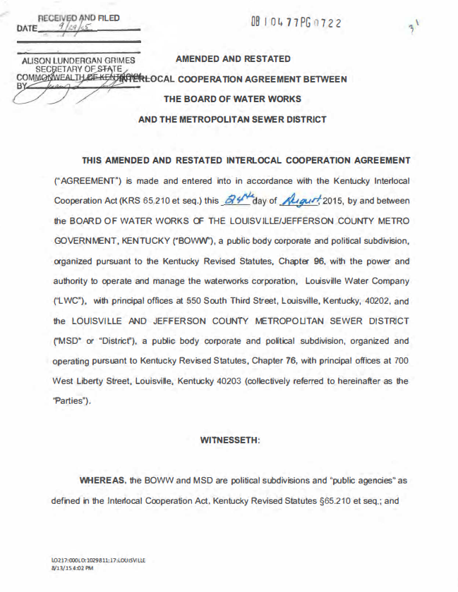
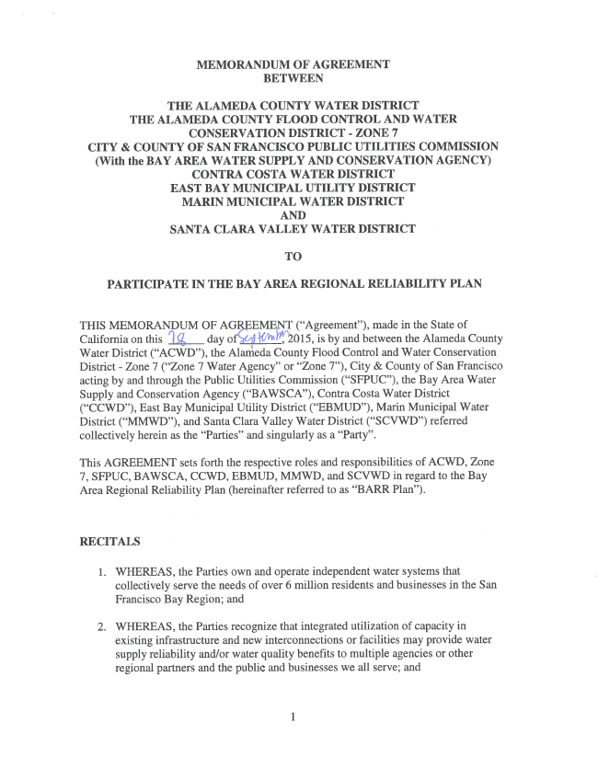
Key terms of the agreement
General purpose
Governance & management structure
Establishes OW Advisory Council
Confirms OWWG
Describes OW Coordinator position
Responsibilities of the parties
NBU additional responsibilities outlined
Sets agreement duration of 3 years
Sources of funds & fund allocation
ONE WATER ROADMAP

Slide 7
One Water Program governance structure
NBU Board
City Council
GBRA Board
Director of Customer Solutions & CAO
Employ & manage OWC
All HR & admin support
OW Advisory Council
Annual report to agency governing bodies
Financial decisions
Strategic guidance
Provide input to NBU on effectiveness of OWC
OW Coordinator (OWC)
Primary POC for OW Program
Manage day to day responsibilities of program
Coordinate OWWG, OWAC activities
Advance shared projects
Manage program budget
OW Working Group
Subject matter experts
Make recommendations to OWAC
Evaluate strategies and project progress
Provide input to OWAC on effectiveness of OWC
ONE WATER ROADMAP

Slide 8
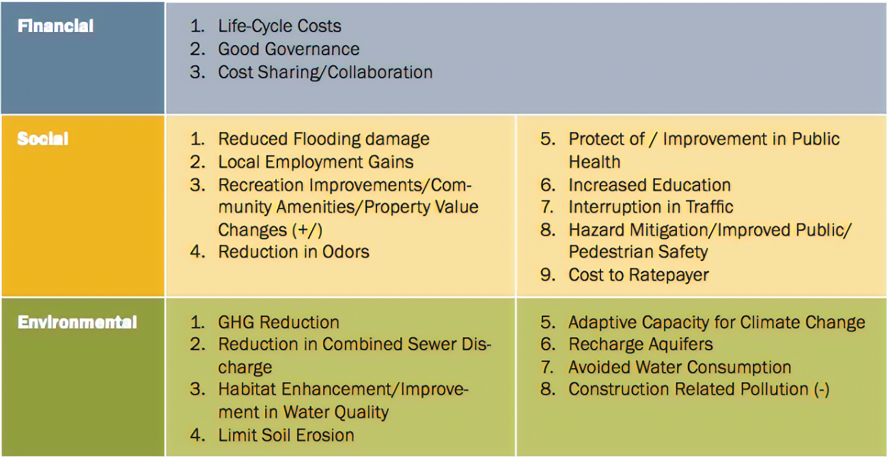
Purpose of program pooled funds
Year One: Establish & engage
Website, logo & collateral materials development
Stakeholder engagement
Education programming
Year Two & on: Advance specific Roadmap activities, such as
Triple-bottom-line project scoring matrix creation & white paper development
One Water-aligned project library creation
Green infrastructure/LID best practice manual
San Francisco PUC, Urban Watershed Framework, 2012

Slide 9
Item for action
Authorize the CEO or His Designee to Negotiate and Execute an Interlocal Agreement with City of New Braunfels and Guadalupe-Blanco River Authority for the One Water Program.
ONE WATER ROADMAP

Slide 10
Next Steps
July 19 | GBRA Board of Director consider Agreement
August 14 | New Braunfels City Council considers Agreement
August date TBD | One Water Community Celebration
ONE WATER ROADMAP

Slide 11
THANK
YOU

Slide 12
What’s Ahead
Action | Lead
Formalize interagency program with an interlocal agreement | NBU, City of New Braunfels & GBRA
Hire and onboard One Water Coordinator | NBU
Establish working committees and advisory council | One Water Coordinator & NBU
Engage community stakeholders | One Water Coordinator & OWWG
Develop 3 to 5 year operational plan | One Water Coordinator & OWWG
Gather partners
Develop plan together
Jointly
Implement plan
ONE WATER ROADMAP

Slide 13
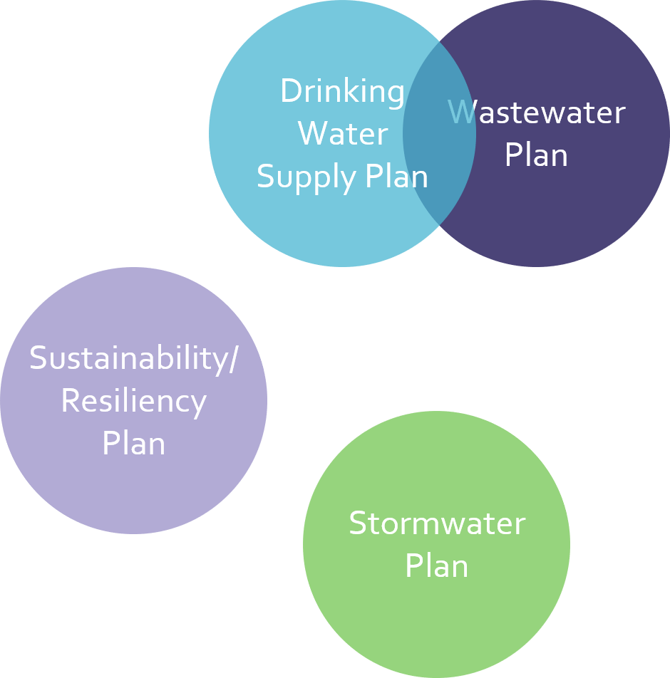
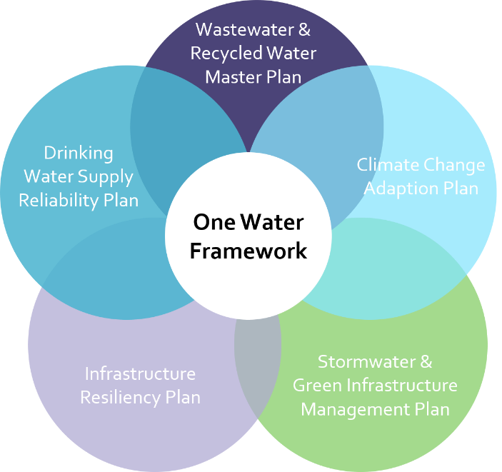
What is One Water?
One Water is an integrated planning and implementation approach to managing finite water resources for long-term resilience and reliability, meeting both community and ecosystem needs.
Water Research Foundation (WRF)
Traditional Approach
One Water Approach
ONE WATER ROADMAP
Notes:
Thinking holistically about our waters – drinking water, wastewater, stormwater and reuse water – and integrating our planning for these

Slide 14
Agencies working together
NEW BRAUNFELS UTILITIES
Adam Willard*
Andrew Cummings
Brent Lundmark
David Hubbard
Dawn Schriewer
Ian Taylor
Jason Theurer
Dr. Judith Dykes-Hoffmann
Lauren Strack
Mike Short
Nancy Pappas
Ryan Kelso
Shawn Schorn
CITY OF NEW BRAUNFELS
GUADALUPE-BLANCO RIVER AUTHORITY
Charlie Hickman*
Elizabeth Edgerton*
Jonathan Stinson*
Lauren Willis*
Nathan Pence
City Manager’s Office
Robert Camareno
Jordan Matney
Planning & Development Services
Jean Drew
Matt Greene*
Christopher Looney
Transportation and Capital Improvements
Carly Farmer*
Garry Ford, Jr.
Watershed Management/Public Works
Phillip Quast*
Parks & Recreation
Ylda Capriccioso
ADDITIONAL MEMBERS
Ashley Evans, Arcadis U.S., Inc.
Emily Warren Armitano, Cynthia & George Mitchell Foundation
Jacqueline Ashmore,
Institute for Sustainable Energy, Boston University
Tom Hegemier,
Doucet and Associates, Inc.
* Joined One Water Working Group after Roadmap completion
Notes:
SARAH

